Slide 1

ADHIPARASAKTHI COLLEGE OF ENGINEERING
G.B. NAGAR, KALAVAI, RANIPET DIST - 632 516.
Model Project Review
Date: 19-05-2025
Symptom-Based AI Medical Diagnosis Chatbot with RAG and Machine Learning Integration
Team Members:
1. Sathish S 510121104033
2. Hari Prasad D 510121104010
3. Aakash S 510121104001

Slide 2

Introduction
AI is revolutionizing healthcare by enabling faster and more accurate diagnoses.
Our project empowers users to receive disease predictions simply by describing their symptoms.
It features chat-based interactions and image diagnosis capabilities for comprehensive support.
This system benefits both patients and healthcare professionals.

Slide 3
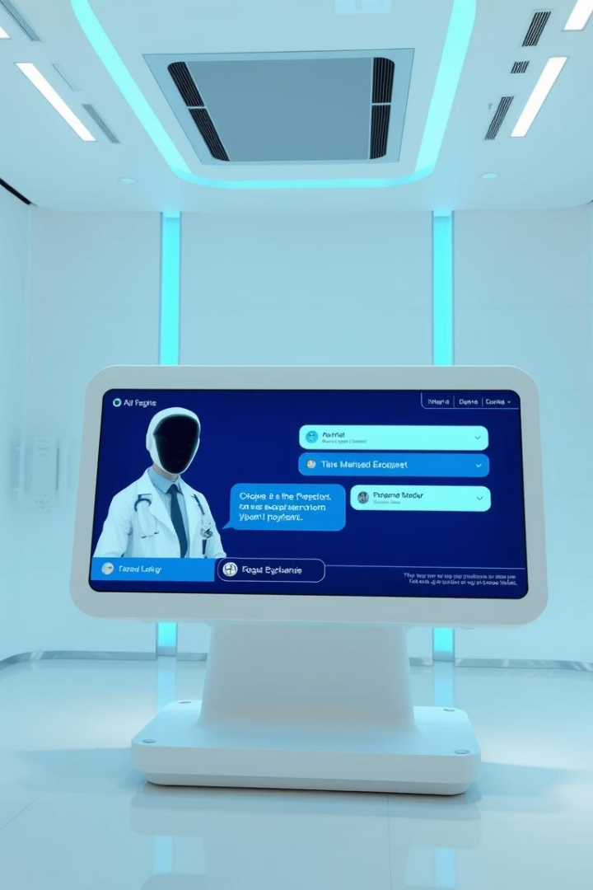
Abstract:
This project, titled "Symptom-Based AI Medical Chatbot with RAG and Machine Learning Integration," presents an intelligent healthcare assistant that predicts diseases based on user-reported symptoms. It combines a machine learning model for symptom-based diagnosis with a Retrieval-Augmented Generation (RAG) framework to provide accurate, context-aware medical responses. The chatbot delivers both predictive results and relevant health information, offering users a smart, interactive, and accessible way to understand their symptoms and possible conditions.

Slide 4
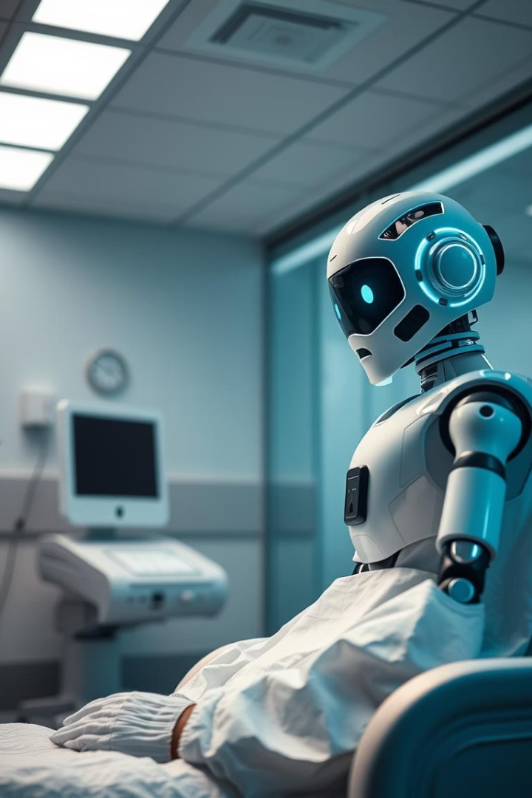
Problem Statement
Limited Symptom Recognition
No Visual Diagnosis
Current symptom checkers do not accept or analyze images like medical reports or photos.
Conventional systems rely on exact keyword matches, which fail with spelling errors or variant phrasings.
Poor Natural Language Support
Users can’t converse naturally with AI, limiting usability and effectiveness.

Slide 5
Project Objectives
Natural Language Understanding
Comprehensive Suggestions
Image-Based Diagnosis
RAG Integration
Improve results by combining retrieval-augmented generation methods with machine learning.
Enable chatbot to comprehend diverse symptom descriptions in everyday language.
Provide tailored advice on diet, medication, and precautions with predictions.
Support diagnosis using uploaded photos or medical imagery for enhanced accuracy.

Slide 6
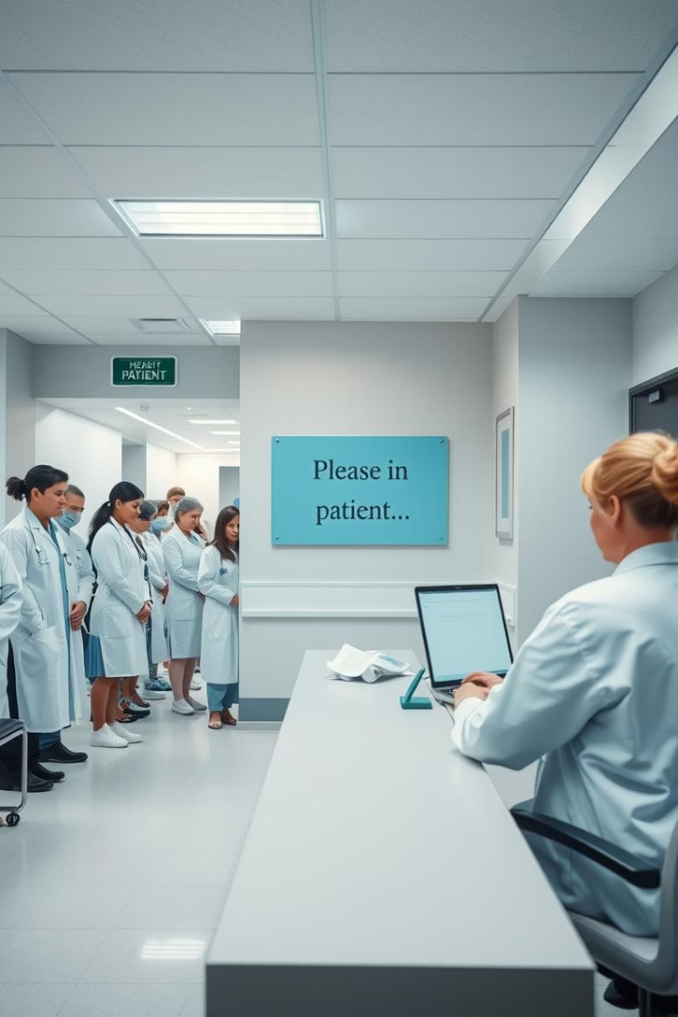
Existing System Overview
Basic ML Model
Limited to direct symptom-to-disease predictions requiring exact inputs.
Lack of Flexibility
No chatbot interface or tolerance for varied symptom phrasing.
No Image Processing
Unable to incorporate or analyze visual medical data.
Low User Friendliness
Interface unsuitable for general public lacking technical skills.

Slide 7
Machine Learning Symptom Prediction Model
Model Training
Prediction & Info Retrieval
Deployment
Trained with scikit-learn on structured symptom datasets for disease classification.
Outputs disease predictions and relevant medical information per input symptoms.
Exposed as a Flask API to enable integration with external applications and services.

Slide 8
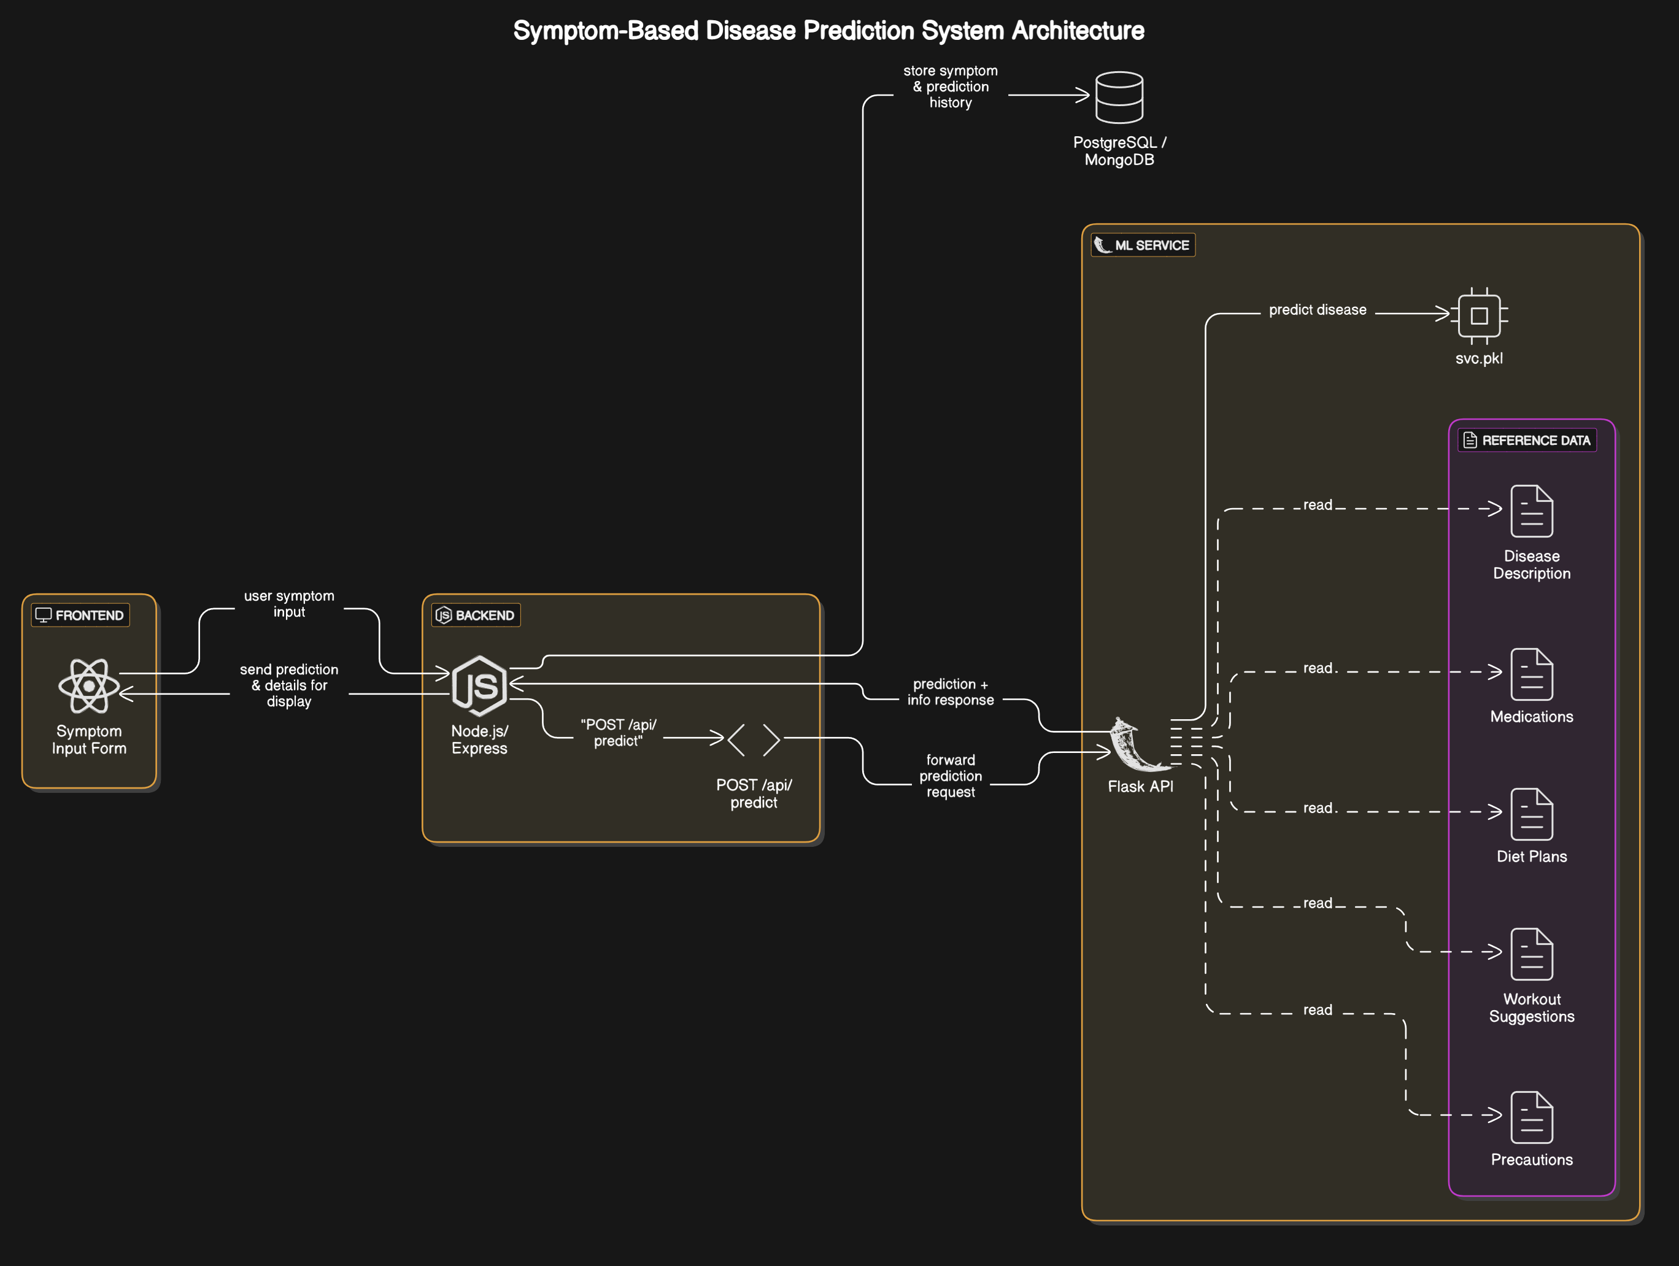

Slide 9






Proposed System
RAG Chatbot
Generates context-aware responses by combining retrieval and large language models.
MongoDB Vector Search
Stores medical documents for quick similarity retrieval based on input context.
Image + Query Diagnosis
Uses Groq AI model for visual medical analysis integrated with the Medical system.

Slide 10
RAG Chatbot Implementation with LangChain
Document Processing
Embeddings Generation
MongoDB Atlas Integration
Smart Answering
Combines retrieval context with LLM generation to deliver precise responses.
PDFs split into chunks with Recursive Character
Text Splitter for Relevant retrieval.
Chunks transformed into vector embeddings using HuggingFace models.
Vector embeddings stored and searched via MongoDB Atlas Vector Search.

Slide 11





RAG Chatbot Flow
User Input
The user types symptoms or questions into the chatbot interface.
LangChain RAG Pipeline
Input is reformatted and passed through a retrieval-augmented generation pipeline.
Vector Database Query
Relevant medical documents are retrieved from MongoDB vector search based on the query.
LLM Summarization
The large language model processes documents to produce a concise, informed answer.
Response Display
The chatbot combines retrieval and generation results to provide a user-friendly reply.

Slide 12
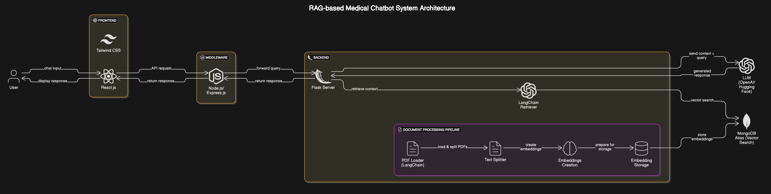

Slide 13
Why We Need an AI Chatbot
🧪 Existing System: Symptom Checker
The current Symptom Checker only identifies exact symptom matches, struggling with typos or variations in user input.
For example, "abdominal swelling, easy bruising, stool and urine color changes, and jaundice“ ❌ Output: Unknown Disease – No valid symptoms provided yields no results due to a mismatch. This limitation leads to user frustration and potential missed diagnoses.

Slide 14
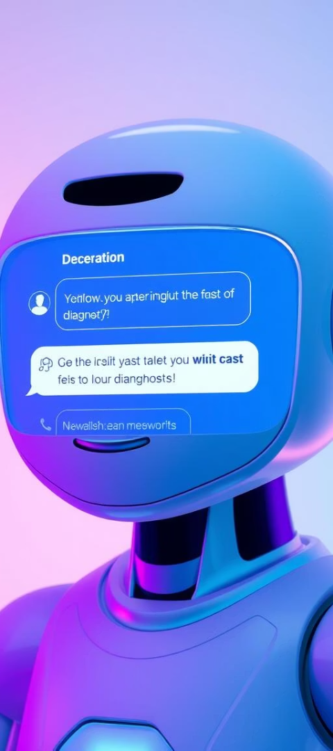
AI Chatbot Solution (RAG + LLM)
Understands natural language and medical context.
Same input gives meaningful output: ✅ "These symptoms may indicate liver disease... Consult a healthcare professional for proper tests."
Uses a fine-tuned LLM + PDF knowledge base to provide detailed, helpful answers.

Slide 15
Image-Based Diagnosis Workflow
Image Upload
1
User submits medical images or photos related to symptoms via chatbot interface.
Groq AI Encoding
2
Image is encoded and analyzed using Groq LLaMA-4 Maverick model for medical insight.
API Integration
3
Groq’s responses are delivered through a FastAPI backend into the User workflow.
Medical Analysis
4
Provides visual diagnostic data to complement textual predictions and advice.

Slide 16
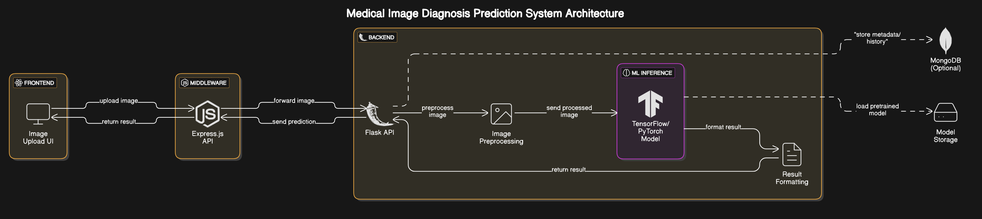

Slide 17
Technology Behind the Solution
Frontend
Backend & APIs
ML & Databases
Knowledge Management
React.js for intuitive and responsive user interfaces.
Node.js for server logic
Groq powers LLM generation
Flask for ML model API
LangChain + PDFPlumber split and process PDFs for chatbot knowledge base.
FastAPI for image diagnosis
MongoDB Atlas stores vector embeddings
HuggingFace for embedding generation

Slide 18

Conclusion and Future Outlook
Advanced AI Tool
User-Centered Design
We successfully developed a sophisticated AI-powered diagnosis platform combining RAG, ML, and image analysis.
The system delivers human-like, helpful answers supporting natural language and visual inputs.
Future Potential
This project lays groundwork for smarter health assistance solutions accessible to wider populations.

